Slide 1
COMPUTER ORGANIZATION
Lecturer : Supeno Djanali (A & E)
Time : Monday/Thursday 07:30 – 10:00
Textbooks : 1. Organisasi Komputer, by Supeno Djanali and Baskoro Adi P.
2. Computer Organization 5th Ed. by Hamacher et.al.
3. Computer Organization and Architecture 8th Ed. by William Stallings
Course Content:
Computer structure, machine instruction, instruction sets, input/output organization, memory system, arithmetic, central processing unit (CPU), pipelining.
Grading : 10% attendance
20% homework & quiz
30% Midterm Exam (ETS)
40% Final Exam (EAS)
Notes:
Supeno Djanali - Teknik Informatika-FTIf

Slide 2
COMPUTER TYPES (1)
Embedded computers are integrated into a larger device or system in order to automatically monitor and control a physical process or environment. They are used for a specific purpose rather than for general processing tasks.
Personal computers have achieved widespread use in homes, educational institutions, and business and engineering office settings, primarily for dedicated individual use.
  Desktop computers serve general needs and fit within a typical personal workspace.
  Workstation computers offer higher computational capacity and more powerful graphical display capabilities for engineering and scientific work.
  Portable and Notebook computers provide the basic features of a personal computer in a smaller lightweight package.

Slide 3
COMPUTER TYPES (2)
Servers and Enterprise systems are large computers that are meant to be shared by a potentially large number of users who access them from some form of personal computer over a public or private network.
Supercomputers and Grid computers normally offer the highest performance. They are the most expensive and physically the largest category of computers. Supercomputers are used for the highly demanding computations needed in weather forecasting, engineering design and simulation, and scientific work.

Slide 4
COMPUTER ORGANIZATION
It explains the function and design of the various units of digital computers that store and process information.
It also deals with the input units of the computer which receive information from external sources and the output units which send computed results to external destinations.
The input, storage, processing, and output operations are governed by a list of instructions that constitute a program.
Notes:
Supeno Djanali - Teknik Informatika-FTIf

Slide 5
STRUCTURE AND FUNCTIONS
Structure describes interconnection between components in computer
Function is the operation of each component as a part of the structure
Computer functions:
  Data processing
  Data storage
  Data movement
  Control
Notes:
Supeno Djanali - Teknik Informatika-FTIf

Slide 6
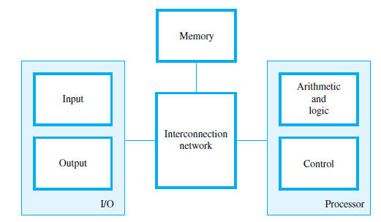
FUNCTIONAL UNITS OF COMPUTER

Slide 7
COMPUTER STRUCTURE
Peripherals
Computer
Central
Processing
Unit
Main
Memory
Computer
Systems
Interconnection
Input
Output
Communication
lines
Notes:
Supeno Djanali - Teknik Informatika-FTIf

Slide 8
CPU SRUCTURE
CPU
Computer
Arithmetic
and
Login Unit
I/O
Registers
System
Bus
CPU
Internal CPU
Interconnection
Memory
Control
Unit
Notes:
Supeno Djanali - Teknik Informatika-FTIf

Slide 9
CONTROL UNIT SRUCTURE
Control Unit
CPU
ALU
Sequencing
Login
Internal
Bus
Control
Unit
Control Unit
Registers and
Decoders
Registers
Control
Memory
Notes:
Supeno Djanali - Teknik Informatika-FTIf

Slide 10
COMPUTER TECHNOLOGY GENERATION
Vacuum tube - 1946-1957
Transistor - 1958-1964
Small scale integration - 1965 on
  Up to 100 devices on a chip
Medium scale integration - to 1971
  100-3,000 devices on a chip
Large scale integration - 1971-1977
  3,000 - 100,000 devices on a chip
Very large scale integration - 1978 -1991
  100,000 - 100,000,000 devices on a chip
Ultra large scale integration – 1991 -
  Over 100,000,000 devices on a chip
Notes:
Supeno Djanali - Teknik Informatika-FTIf

Slide 11
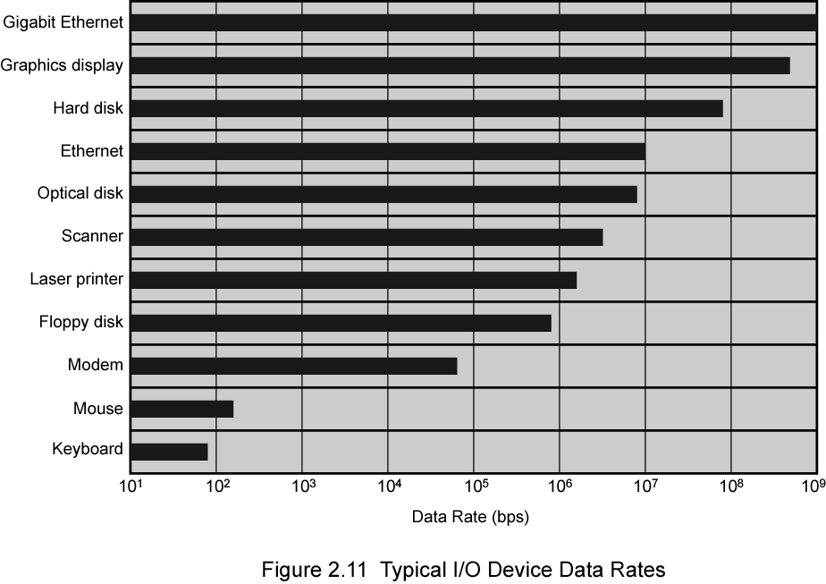
Typical I/O Device Data Rates

Slide 12
Pentium Evolution (1)
1971 - 4004
  First microprocessor
  All CPU components on a single chip
  4 bit
Followed in 1972 by 8008
  8 bit
  Both designed for specific applications
1974 - 8080
  Intel’s first general purpose microprocessor
Notes:
Supeno Djanali - Teknik Informatika-FTIf

Slide 13
Pentium Evolution (2)
8080
  first general purpose microprocessor
  8 bit data path
  Used in first personal computer – Altair
8086
  much more powerful
  16 bit
  instruction cache, prefetch few instructions
  8088 (8 bit external bus) used in first IBM PC
80286
  16 Mbyte memory addressable
  up from 1Mb
80386
  32 bit
  Support for multitasking

Slide 14
Pentium Evolution (3)
80486
  sophisticated powerful cache and instruction pipelining
  built in maths co-processor
Pentium
  Superscalar
  Multiple instructions executed in parallel
Pentium Pro
  Increased superscalar organization
  Aggressive register renaming
  branch prediction
  data flow analysis
  speculative execution

Slide 15
Pentium Evolution (4)
Pentium II
  MMX technology
  graphics, video & audio processing
Pentium III
  Additional floating point instructions for 3D graphics
Pentium 4
  Note Arabic rather than Roman numerals
  Further floating point and multimedia enhancements
Itanium
  64 bit
  Multi core
Itanium 7
  Hardware enhancements to increase speed
Itanium ??

Slide 16
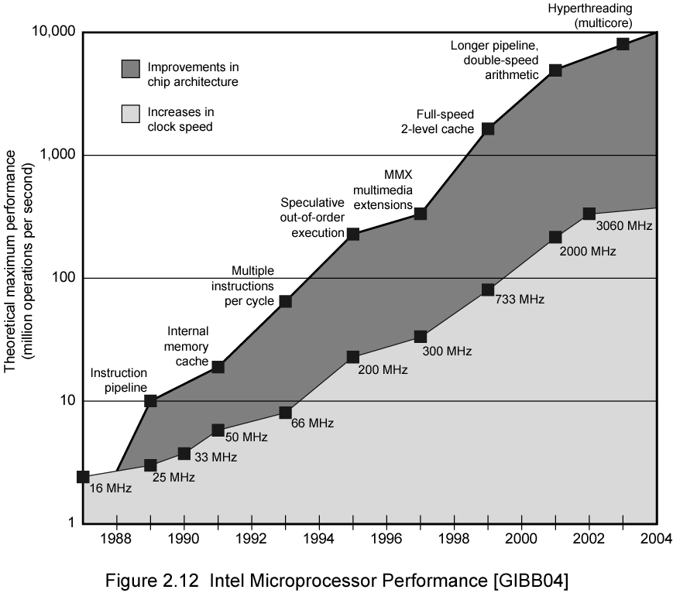
Intel Microprocessor Performance

Slide 17
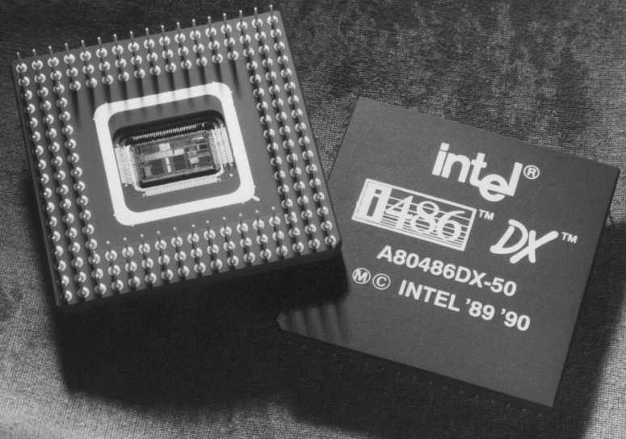
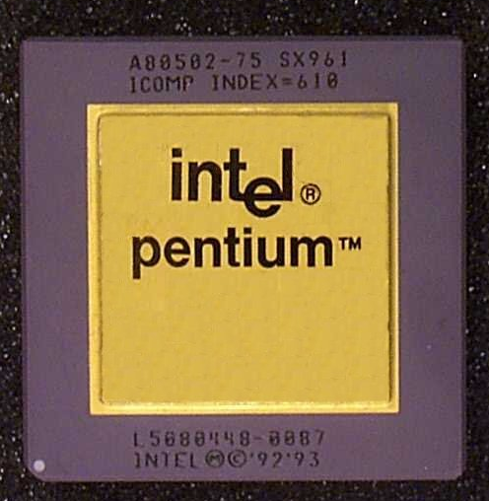
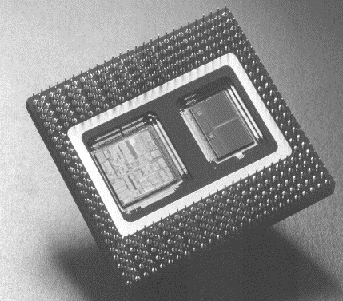
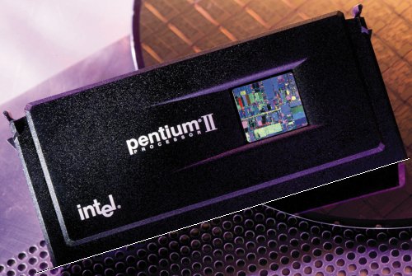
Processor Chip

Slide 18
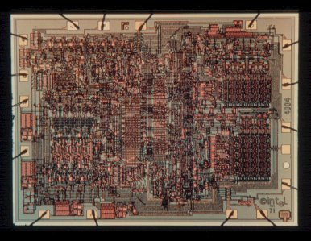
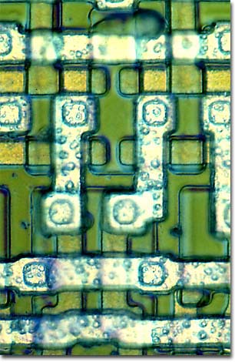
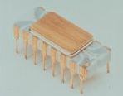
Intel 4004 Die Photo
Introduced in 1970
  First microprocessor
2,250 transistors
12 mm²
108 KHz

Slide 19
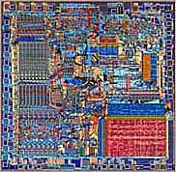
Intel 8086 Die Scan
29,000 transistors
33 mm²
5 MHz
Introduced in 1979
  Basic architecture of the IA32 PC

Slide 20
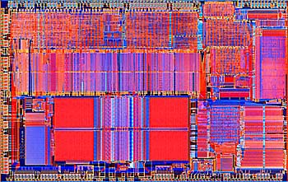
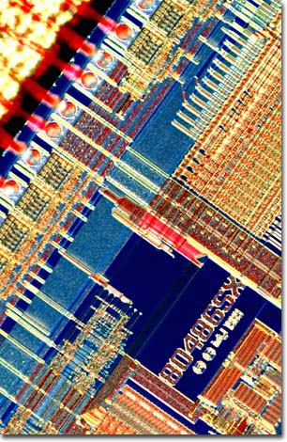
Intel 80486 Die Scan
1,200,000 transistors
81 mm²
25 MHz
Introduced in 1989
  1st pipelined implementation of IA32

Slide 21
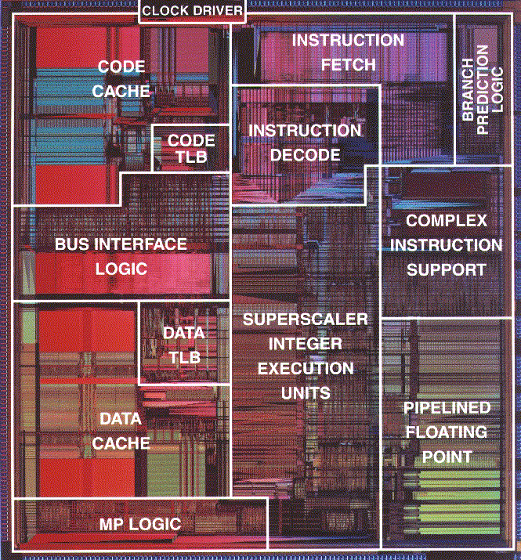
Pentium Die Photo
3,100,000 transistors
296 mm²
60 MHz
Introduced in 1993
  1st superscalar implementation of IA32

Slide 22
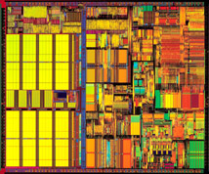
Pentium III
9,500,000 transistors
125 mm²
450 MHz
Introduced in 1999

Slide 23
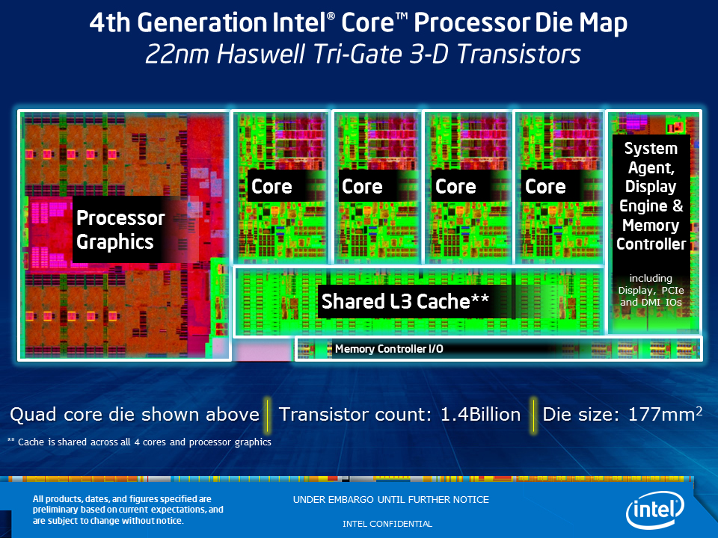
INTEL CORE I5
1.400.000.000 transistors
177 mm²
3.1 GHz
Introduced Q2, 2015

Slide 24
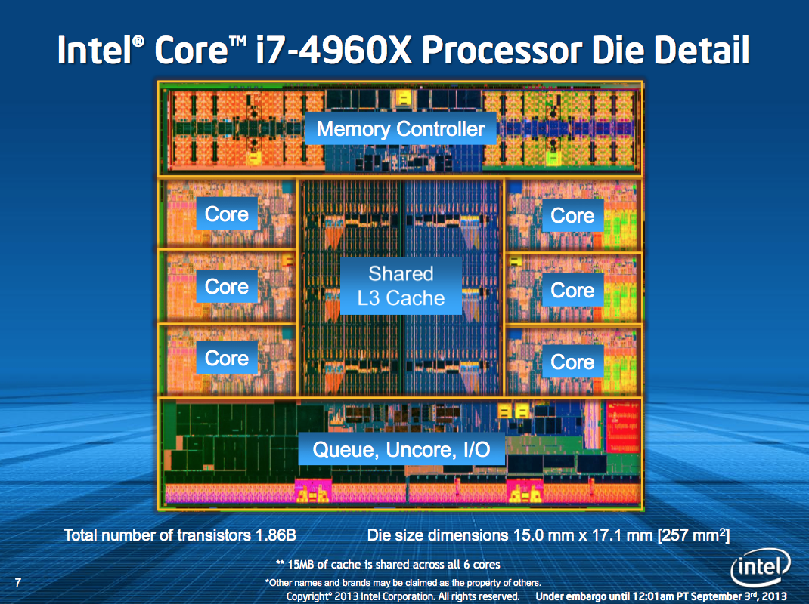
INTEL CORE I7
1.860.000.000 transistors
257 mm² (15 x 17.1)
4 GHz
Introduced Q3, 2015

Slide 25

COMPUTER STRUCTURE

Slide 26

Computer Structure of IAS
(Institute for Advanced Studies-1952)
1000 x 40 bit words
  Binary number
  2 x 20 bit instructions
Set of registers (storage in CPU)
  Memory Buffer Register
  Memory Address Register
  Instruction Register
  Instruction Buffer Register
  Program Counter
  Accumulator
  Multiplier Quotient

Slide 27
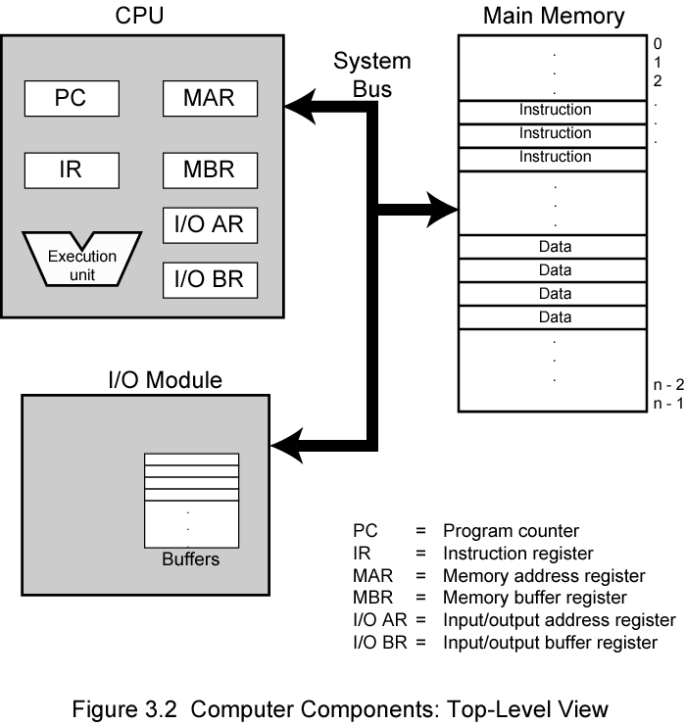
COMPUTER COMPONENTS

Slide 28

INSTRUCTION CYCES
Two cycles:
  Fetch cycle
  Execute cycle

Slide 29
Fetch Cycle
Program Counter (PC) contains address of the next instruction
Processor fetch instruction from memory whose address is given in PC
Increment PC
Place instruction in IR (Instruction Register)
Processor interprets the instruction and execute it

Slide 30
Execute Cycle
Processor-memory
  data transfer between CPU and main memory
Processor I/O
  Data transfer between CPU and I/O
Data processing
  Arithmetic or logic operation
Control
  Changes of operation sequence; example: jump; goto
Combination of the above

Slide 31
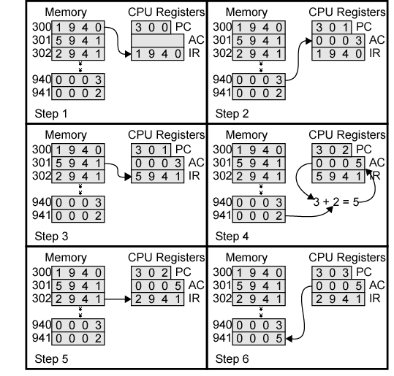
Example of Program Execution
2
3
4
5
6

Slide 32
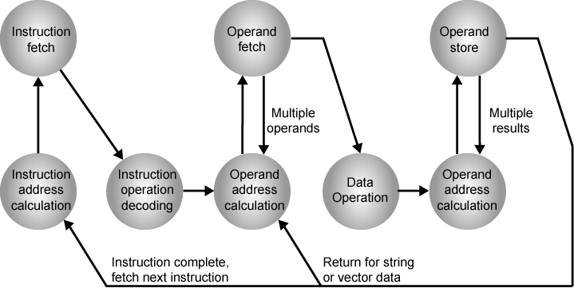
State Diagram of Instruction Cycle

Slide 33
HOMEWORK
Check hardware & software your computer
If you have a chance to buy a new computer, write down the computer specification that you want to buy. Why?
Do all exercises in Chapter 1 in book reference 1.
Due next week

